Slide 1
Frames and frameset

Slide 2
Html Frames:
HTML frames are used to divide your browser window into multiple sections where each section can load a separate HTML document.
A collection of frames in the browser window is known as a frameset.
The window is divided into frames in a similar way the tables are organized: into rows and columns.
Creating Frames
To use frames on a page we use <frameset> tag instead of <body> tag.
The <frameset> tag defines, how to divide the window into frames.
The rows attribute of <frameset> tag defines horizontal frames and cols attribute defines vertical frames.
Each frame is indicated by <frame> tag and it defines which HTML document shall open into the frame.

Slide 3
Following is the example to create three horizontal frames:
<html>
<head>
<title>HTML Frames</title>
</head>
<frameset rows = "10%,80%,10%">
<frame name = "top" src = "/html/top_frame.htm" />
<frame name = "main" src = "/html/main_frame.htm" />
<frame name = "bottom" src = "/html/bottom_frame.htm" />
</frameset>
</html>

Slide 4
Following is the example to create three horizontal frames:
<html>
<head>
<title>HTML Frames</title>
</head>
<frameset cols = "25%,50%,25%">
<frame name = "left" src = "/html/top_frame.htm" />
<frame name = "center" src = "/html/main_frame.htm" />
<frame name = "right" src = "/html/bottom_frame.htm" />
<noframes>
<body>Your browser does not support frames.</body>
</noframes>
</frameset>
</html>

Slide 5
The <frameset> Tag Attributes
cols | Specifies how many columns are contained in the frameset and the size of each column. Absolute values in pixels. For example, to create three vertical frames, use cols = "100, 500, 100". A percentage of the browser window. For example, to create three vertical frames, use cols = "10%, 80%, 10%".
rows | This attribute works just like the cols attribute and takes the same values, but it is used to specify the rows in the frameset.
border | This attribute specifies the width of the border of each frame in pixels. For example, border = "5". A value of zero means no border.
frameborder | This attribute specifies whether a three-dimensional border should be displayed between frames. This attribute takes value either 1 (yes) or 0 (no). For example frameborder = "0" specifies no border.

Slide 6
The <frame> Tag Attributes
src | This attribute is used to give the file name that should be loaded in the frame. Its value can be any URL. For example, src = "/html/top_frame.htm" will load an HTML file available in html directory.
name | This attribute allows you to give a name to a frame. It is used to indicate which frame a document should be loaded into. This is especially important when you want to create links in one frame that load pages into an another frame, in which case the second frame needs a name to identify itself as the target of the link.
marginwidth | This attribute allows you to specify the width of the space between the left and right of the frame's borders and the frame's content. The value is given in pixels. For example marginwidth = "10".
marginheight | This attribute allows you to specify the height of the space between the top and bottom of the frame's borders and its contents. The value is given in pixels. For example marginheight = "10".
scrolling | This attribute controls the appearance of the scrollbars that appear on the frame. This takes values either "yes", "no" or "auto". For example scrolling = "no" means it should not have scroll bars.

Slide 7
Browser Support for Frames
If a user is using any old browser or any browser, which does not support frames then <noframes> element should be displayed to the user.
So you must place a <body> element inside the <noframes> element because the <frameset> element is supposed to replace the <body> element, but if a browser does not understand <frameset> element then it should understand what is inside the <body> element which is contained in a <noframes> element.
You can put some nice message for your user having old browsers. For example, Sorry!! your browser does not support frames. as shown in the above example.

Slide 8
HTML - Iframes
You can define an inline frame with HTML tag <iframe>.
The <iframe> tag is not somehow related to <frameset> tag, instead, it can appear anywhere in your document.
The <iframe> tag defines a rectangular region within the document in which the browser can display a separate document, including scrollbars and borders.
An inline frame is used to embed another document within the current HTML document.

Slide 9
Example
<html>
<head>
<title>HTML Iframes</title>
</head>
<body>
<p>Document content goes here...</p>
<iframe src = "/html/menu.htm" width = "555" height = "200">
Sorry your browser does not support inline frames.
</iframe>
<p>Document content also go here...</p>
</body>
</html>

Slide 10
<html>
<head>
<title>HTML Iframes</title>
</head>
<body>
<p>Document content goes here...</p>
<iframe src="menu.htm" width="555" height="200">
</iframe><br>
<iframe src = "menu.html" width = "800" height = "800">
</iframe>
<p>Document content also go here...</p>
</body>
</html>

Slide 11
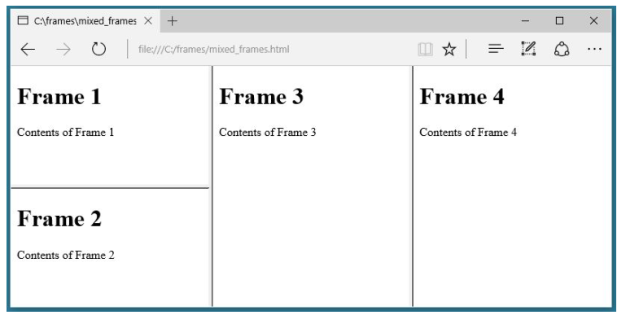
Mixed frameset
<frameset cols="*,*,*">
<frameset rows="*,*">
<frame src="frame_1.html">
<frame src="frame_2.html">
</frameset>
<frame src="frame_3.html">
<frame src="frame_4.html">
< /frameset>

Slide 12
Frame a
Frame b
Frame c
<html>
<frameset rows="50%,50%">
<frame src="frame_a.htm">
<frameset cols="25%,75%">
<frame src="frame_b.htm">
<frame src="frame_c.htm">
</frameset>
</frameset>
</html>

Slide 13
frame_a
frame_b
frame_c
frame_d
<html>
<frameset rows="50%,50%">
<frameset cols="50%,50%">
<frame src="frame_a.htm">
<frame src="frame_b.htm">
</frameset>
<frameset cols="50%,50%">
<frame src="frame_c.htm">
<frame src="frame_d.htm">
</frameset>
</frameset>
</html>

